Slide 1
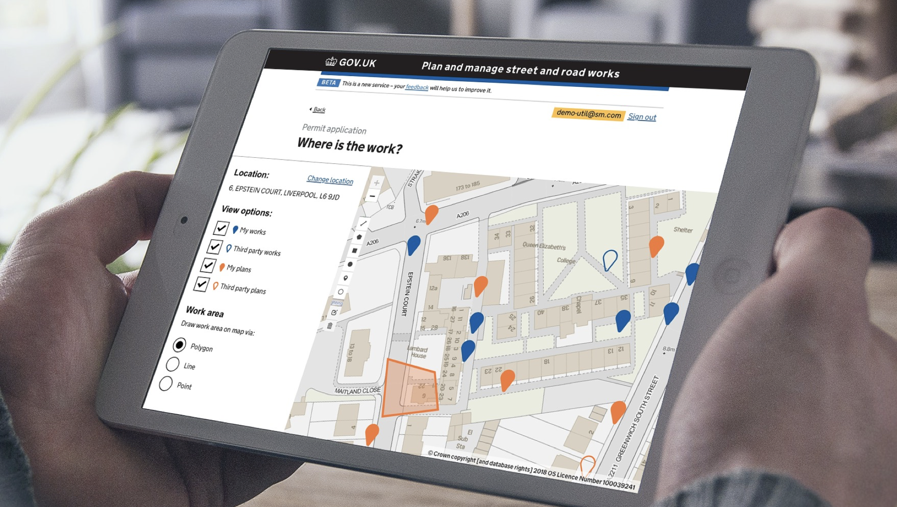

Street Manager Change management strategy
@ Crown copyright

Slide 2
Contents
Introduction
What is change management
Purpose and considerations
Benefits of change management
Components of change management
Links to other change elements
Vision for effective change management
Establish current state of stakeholder environment
Establish targets for desired end state
Plan interventions
Execute and measure

Slide 3
Introduction
Purpose
This document outlines the approach and best practice to Change management to support the transition to Street Manager by enabling your stakeholders to act in a way that facilitates the progress of transition.
The document outlines the different stages in the change management process and contains guidance on recommended activities and engagement techniques. More importantly, it contains a number of questions that you may want to consider when delivering Change management in particular with relation to Street Manager.
The document is intended for guidance only and whilst Change management is a key part of any project or initiative, you are free to use any method, model or approach that suits you and your organisation’s needs.
Disclaimer
The information provided in this pack is purely a recommendation and it is up to you to edit the content in line with your organisation’s transition plan. What the right approach for your organisation is will be dependent on a number of factors such as how and when you plan to move to Street Manager environment, and what are the specific needs and preferences of your stakeholders.

Slide 4




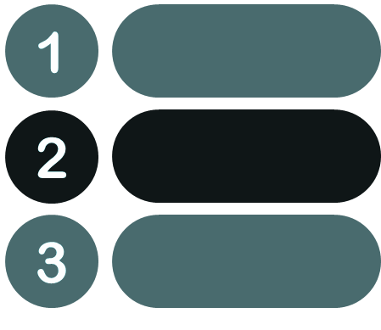






What is change management?
CHANGE MANAGEMENT IS
the process of planning, executing and measuring the success of a set of actions so that all your internal and external stakeholders can get from point A to point B - i.e. from what they do and think today to enabling or going through the transition to Street Manager
Initial vision
Analysis
Set targets
Plan interventions
Execute
Measure
Now
Street Manager
IT FOCUSES ON
PEOPLE
Who needs to be involved in the change process?
Who needs to be engaged, when and how?
WIDER ORGANISATION
What related processes, systems and ways of working need to be in place?
TO ENSURE THAT YOU ARE READY TO TRANSITION TO STREET MANAGER FROM BOTH PRACTICAL AND EMOTIONAL PERSPECTIVE

Slide 5




Key change management considerations
Change management takes into consideration links and dependencies with all other aspects of change:
processes, technology, ways of working, skills and behaviours needed to deliver BAU (business as usual)
You need to consider the wider picture - you might have more stakeholders than you originally imagine!
This means that your ‘stakeholders’ are not just your organisation’s employees that will be using Street Manager, but also:
the staff members working on works management systems (including Street Manager),
the IT vendors or teams that will develop your API or help introduce Street Manager into your IT environment,
the internal management team that will need to sign off any major transition decisions,
the procurement teams that will manage relationships with IT vendors
the LHAs, Utilities and contractors that you communicate with whose own transition timelines might impact you,
the external regulatory bodies that you might need to comply with.
Your own highways works teams and contractors if you are a local authority.
It is anyone who might be impacted by or impact how and when you will transition to Street Manager!
Change management is about the management of the ‘people’ element on any change initiative based on understanding of their circumstances.
it is focusing on what their concerns are, addressing them if possible, and supporting and mitigating their challenges if needs cannot be fully met. Then comes thinking of how and by what means to achieve that.
Finally, change management is not just communications or training
they are just two approaches that you can take to help achieve your engagement objectives, but there are many other ways to change their behaviours to support transition, e.g. self-managing communities
5

Slide 6



Benefits of change management
Enabling stakeholders to align around a common objective
Facilitating tailored ‘user’-centric approach
Understanding and actioning of risks and opportunities
No change initiative can be successful if the people that will be impacted by it, or have an interest in it, are not on board and supportive.
Change management enables you to align all internal and external stakeholders so that they understand, approve of and deliver their role in the transition process.
People are the most complex and impactful aspect of any change process and the behaviour of each stakeholder is based on specific to them circumstances.
Rigorous approach to change management enables you to identify these drivers of behaviour in order to develop and execute truly effective interventions.
Knowing who your key supporters and challengers are allows you to take advantage of opportunities to make transition smoother and faster as well as mitigate any risks.
Understanding the dependencies between stakeholders, processes and technologies enables overall resilient project governance and management

Slide 7
Components of change management
Initial vision
Analysis
Set targets
Plan interventions
Execute
Measure
Now
Street Manager
1) Establish the initial vision for where stakeholders need to be
2) Establish the current state of the stakeholder environment
3) Validate where you want and can get to
4) Design and plan approach and activities to achieve objectives
5) Deliver planned activities
6) Measure the effectiveness of interventions, update, and monitor progress
Who needs to approve the use of Street Manager?
Who needs to adopt and use Street Manager?
Who needs to enable your IT infrastructure to transition to Street Management environment?
Who is impacted by the change?
Who will have influence over how and when you transition?
Who is supportive and who is resistant?
What risks and opportunities result from the above?
Establish objectives that need to be achieved to enable transition, but are also realistic taking into account the findings from the analysis.
Examples include communications, training delivery, communities and user groups, engagement via leadership, champions or another party, etc.
Some of these may be delivered by people in your organisation, some may be delivered by external stakeholders, some may be delivered with the help of DfT, but you will be ultimately responsible for management and coordination.
Collect feedback to understand how effective the activities have been. Based on outcomes adjust approach if needed. Monitor overall progress to get to desired end state.

Slide 8
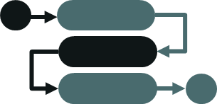



Links and dependencies with other change elements
Change management is focused on people, but not in isolation. Think about:
Processes
Systems and technology
Would any of the works management processes change?
Who needs to develop and approve the new workflows?
Who will be involved in delivery?
When and how will these be introduced to people?
Would there be any job role or structural changes resulting from the new processes?
Would you be using the Street Manager website or linking via API? What are the implications for training?
Who would be developing IT and what are the timelines?
Who would be responsible for integrating the API or the website into your overall IT environment?
Who would be signing off go-live and transition decisions?
Who should be involved in any testing?
Skills and behaviours
Ways of working
What skills and behaviours will be needed to deliver works management under Street Manager effectively after the transition is complete?
Are these available currently, are there any gaps?
How can you build or acquire the required skills?
What knowledge needs to be preserved from the current skill set despite any changes?
Would there be a need for any changes in the ways of working e.g. collaboration between teams and individuals, different type or level of handoffs?
Would there be a need for any change in behaviours?
Would there be any changes in ways of working and communicating with external organisations?

Slide 9






Vision for effective change management
There is no single recipe for success, however to be effective, the delivery of change management should ensure:
Engagement of all stakeholders so that they understand the direction of travel and the role they play;
All stakeholders feel as motivated, empowered and ready for the change as possible;
‘User’-centric approach is taken from beginning to end;
and success is not assumed, but validated via continuous monitoring and assessments
Everyone is aligned around a clear objective and purpose
People at all levels can answer the question “what’s in it for me if I change?”
The success of change management is monitored and measured
Strategic direction
Motivation
Measured
Change management is tailored to individual circumstances
Delivering Successful Change
People at all levels are engaged and empowered to take an active role in driving the change
User-centric
Engagement
Training
People are equipped with what they need to succeed to achieve the desired business results
9

Slide 10
Establish the current state of the stakeholder environment
@ Crown copyright

Slide 11
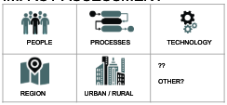
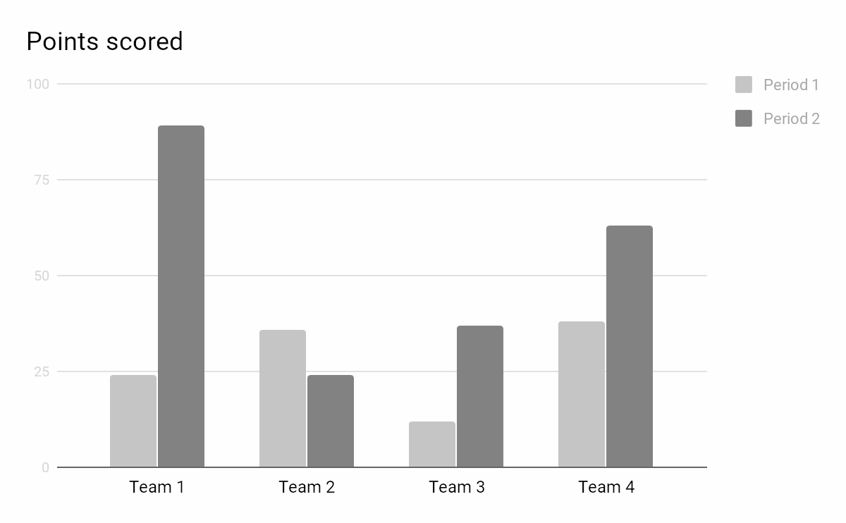
Suggested analyses
These are examples of suggested analyses that you can perform to establish a picture of the current environment.
You can use the tools included in Playbook part one (Link) if you wish.
Note, this is not an exhaustive list, but simply a recommendation - you can do whatever works for you and gives you an understanding of where your stakeholders are currently.
IMPACT ASSESSMENT
High-level analysis of the impact that adoption of Street Manager will have on your:
People,
Processes,
Technology, and
Ways of working
OUTCOMES
Identification of stakeholders that will be significantly impacted which means they might need extra support
High-level analysis of current level of readiness to transition:
Understanding of change
Transition challenges
Help needed to get ready
Organisation readiness to commence and complete transition
OUTCOMES
Understanding how ready individual stakeholders are as well as what can help them to prepare
READINESS ASSESSMENT
High-level analysis of each sentiments and attitudes:
Interest in project and ability to influence others
Level of support / resistance
OUTCOMES
Classifying stakeholders into Champions, Adopeters, Observers, Opposers and Blockers
Prediction of behaviours
Insight to inform engagement strategies for each group
SENTIMENT ASSESSMENT
Blocker
Champion
Power
Observer
Opposer
Adopter
Level of support

Slide 12
Recommended approach to categorise stakeholders
NOTE: This model requires an understanding of the level of support/resistance. If these are not known, you might want to consider using the alternative Influence-Interest matrix on next slide
High
INFLUENCE - SENTIMENT categorisation
Purpose: This model splits stakeholders into 5 groups based on how influential they are and how supportive they are of the project.
I N F L U E N C E
 | SUPPORT FOR PROJECT
BLOCKER
CHAMPION
Classification | Recommended engagement approach
Champion: High Influence - Supportive | Priority stakeholders - Build close relationship to turn them into allies, use them as advocates or change champions within communities
Adopter: Low Influence - Supportive | Engage with them sooner rather than later to keep them supportive, try to empower them to become champions
Observer: High/Low Influence - Neutral | Monitor them (especially if high power), try to engage to make them supportive (e.g. via champions)
Opposer: Low Influence- Resistant | Bring them into supportive environment (e.g. champion community), monitor for potential increase of their power
Blocker: High Influence - Resistant | Priority stakeholders - Engage and support them to reduce resistance / move them towards neutral or supportive. Monitor their engagement with and influence over other stakeholders
OBSERVER
OPPOSER
ADOPTER
Low
High
Good to consider:
- All internal and external stakeholders: users, other employees, management, DfT, other LHAs/Utilities, contractors, IT vendors, etc. You can do this at individual, team or organisation level, or a mixture of these
- Who does the successful transition to Street Manager really depend on (they will have High Influence)
- Who can influence how other stakeholders behave (they will have High Influence)
- If someone is positive, are they able to help progress transition faster or improve sentiments within others (if yes, they will be Champions, if no - Adopters)
- If someone is negative, are they able to prevent or significantly slow down transition (if yes, they will be Blockers, if no - Opposers)

Slide 13
Alternative method
NOTE:
Use this only as an alternative method if the sentiments (levels of support and resistance) are not known. The matrix in the previous slide is recommended because it is the more comprehensive one
INFLUENCE - INTEREST matrix
Purpose: It allows you to plot your stakeholders on the matrix based on (1) how much influence/power they have over a project, and (2) how much interest they have in it /how much they will be impacted by it.
The matrix also recommends key actions for each quadrant:
Good to consider:
- All internal and external stakeholders: users, other employees, management, DfT, other LHAs/Utilities, contractors, IT vendors, etc. You can do this at individual, team or organisation level, or a mixture of these
- Who does the successful transition to Street Manager really depend on (they will have High Influence/Power)
- Who will be most impacted by the change in their daily job (they will have Highest Interest/Impact)
High
I N F L U E N C E / P O W E R
 | I N T E R E S T / I M P A C T
E.g. Management
E.g. API developers
Add and move
Add and move
Classification | Recommendation
High - High | Manage closely - key stakeholders
High Influence/Power - Low Interest/Impact | Keep satisfied
Low Influence/Power - High Interest/Impact | Keep informed
Low - Low | Minimum engagement as needed
E.g. SM UI users
Add and move
Add and move
Low
High
NOTE: These are just some examples and their location is not necessarily true for your organisation. If you decide to use this matrix, move them around and add more stakeholder boxes as needed

Slide 14


Risks and opportunities
Once you have completed the relevant analyses and categorisation, note down any resulting risks and opportunities
Opportunities
Add here the opportunities you have identified
Good to consider:
Is anyone acting as an advocate already?
How can you engage and empower Champions (supportive and influential stakeholders) to act as advocates and help bring others on board?
Can you help empower Advocates to become Champions within their teams / communities / organisations if not in the wider environment?
Can you build working groups and community around powerful supportive stakeholders so that they help drive change management locally?
Can sentiments be improved so that Observers become supportive and the resistant become neutral or supportive?
Risks
Add here the opportunities you have identified
Good to consider:
What makes the Blockers and Opposers resistant?
Are there any stakeholder needs that the project will not be able to address and what would be the impact of this?
Is there any risk that the level of support might drop?
Is there a chance that Blockers might influence Opposers and Observers?
If a team has a high saturation of Opposers, can they collectively have big influence and turn into a Blocker?
Are there any other external factors that need to be considered?
To what extent can behaviours be predicted?

Slide 15
Set targets for where you want and can get to
@ Crown copyright

Slide 16
Setting change management targets for each stakeholder group
Below is a recommended set of high-level targets associated with each type of stakeholder. However, this list is not exhaustive or prescriptive and it might not be relevant to every individual within the stakeholder group. It is up to you to establish these based on the categorisation you use and the knowledge you have for each stakeholder or stakeholder group
Stakeholder category | Target: What are we trying to achieve with the use of change management? (these are recommendations only)
Champion | 1) Keep them supportive 2) Engage, empower and educate them to act as advocates 3) If possible, use them to bring others on board by setting up communities aligned around them
Adopter | 1) Keep them supportive 2) If possible, empower them to act as advocates within their teams
Blocker | 1) Understand rationale for behaviour and sentiments 2) If possible, make them less resistant by meeting their needs or supporting them to resolve challenges 3) Monitor and neutralise (if possible) the extent to which they can influence others
Opposer | 1) Understand rationale for behaviour and sentiments 2) If possible, make them less resistant by meeting their needs or supporting them to resolve challenges 3) Monitor the extent to which they can influence others and keep them away from Blockers and other Opposers
Observer | 1) Monitor their sentiments to ensure they do not become resistant
Good to consider
You might want to consider setting targets for indivIdual stakeholders especially if they are among the high influence group (Champions and Blockers). For example, you might want to convert a certain Blocker into a supporter, whilst with another Blocker the more realistic target might be to try and neutralise their power
Make sure that targets align to overall objective to transition to Street Manager, but at the same time are realistic - e.g. if you know that you cannot meet the needs of a certain resistant stakeholder, it might be more reasonable to focus on making them neutral by supporting them to go through challenges, instead of pushing to make them supporters

Slide 17
Plan interventions
@ Crown copyright

Slide 18





Stakeholder management approach
There are a number of ways to engage with stakeholders in order to achieve change management objectives. Below are listed a few examples of recommended techniques that you can use, however this is not an exhaustive list - you do not need to use them all and you should add to the list anything that feel relevant and suitable for your organisation and stakeholders.
The main idea is that these address the ‘What is in it for me’ question for each stakeholder and help you move them to the desired end state to ultimately ensure successful transition to Street Manager.
Communications
Training
DfT support
Communities engagement
Working groups
Continuous open, honest, trust-based two-way communication to ensure that stakeholders are engaged, understand their role and the overall objective, and feel informed and listened to.
Feedback is also a crucial element of change management - this ensures that you know where your stakeholders are and can show them that their opinion matters.
Training on system, processes and workflow changes should be delivered to those that will be involved in works management via Street Manager. Non-users might also benefit from education on new processes and ways of working.
DfT will provide you with business change support in the form of materials (Business change Playbook) as well as regular communication and training support. It is up to you to decide how to use that support and how to disperse it within your stakeholder environment.
You and your stakeholders can join local and regional communities that can serve as support network for organisations - e.g. for regional transitioning, or API transitioning.
You can also establish communities within your organisation (e.g. specific departments or regions) and use Champions (supportive influential stakeholders) to help get the rest on board.
You can set up cross-team / cross-region working groups to facilitate decision making and speed up transition (this is particularly relevant for large multi-regional organisations).
This approach enables you to break down transition into smaller sub-projects by empowering trusted stakeholders to drive change in their areas.

Slide 19
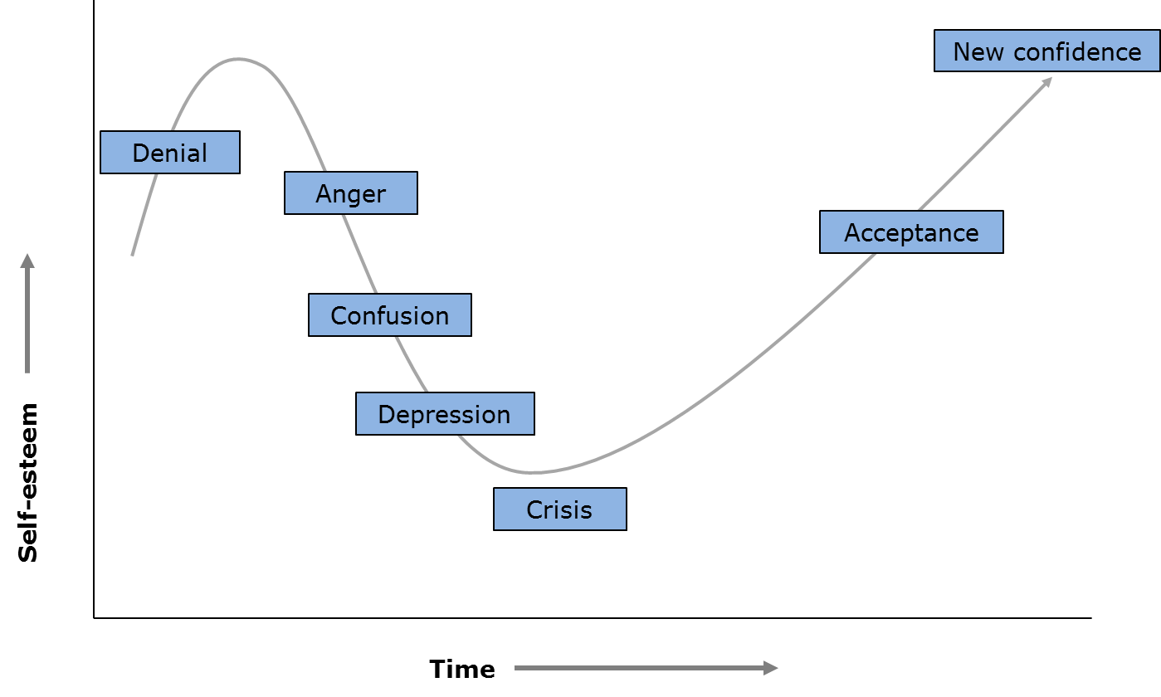
Useful tips to have in mind
Regardless of what techniques you decide to use, think of what you want your stakeholders to:
Feel
Know
Do
Often people unconsciously make the mistake of focusing either on only one or two of those elements when engaging with people, which eventually makes engagement less effective.
If you want to inform your stakeholders about something, think about how you deliver this piece of information and the ‘so what is next’ actions that you want them to take.
If you want them to do something, make sure they have the information they need to undertake the activity.
And ultimately, always think about how you want them to feel and whether they actually feel that way following your engagement.
Also, consider the change resistance model below.
We, people, are naturally prone not to welcome changes because we are afraid of the unknown and because we are apprehensive to step out of our comfort zone. Hence we typically tend to go through the below stages until we actually feel confident to make this step and change.
If a stakeholder is resistant, try to understand where on this model they are and base your engagement accordingly.

Slide 20
Tailored engagement
Use the template below to document the right approach for each stakeholder / stakeholder group
One size never fits all. Each of your stakeholders - and quite possibly some of the individual stakeholders - will need a tailored approach that applies differently one or more of the stakeholder management techniques. For example:
Not every stakeholder might need training, and those who do might differ in the level of detail required
You might want to build communities around some Champions, but this technique might not work well with everyone
Including a Blocker in a working group and making them feel part of your project might be the key to winning their support
Stakeholder group | What are we trying to achieve with change management? | How would each approach be applied to each group / stakeholder? |  |  |  |  |  | When to engage?
 |  |  |  |  |  |  | Anything else?
Champion
Adopter
Blocker
Opposer
Observer

Slide 21
Stakeholder engagement roadmap
(DfT delivery)
Below is an indicative roadmap of Business change activities that DfT will offer to your and the other organisations transitioning to Street Manager. You can use this to develop your own change management roadmap and align it with relevant activities provided by DfT.
Tbc - To align to SM releases
Stream | Pilot | Private beta |  | Public beta
 | Mar - Apr | May - Jul | Aug - Oct | Nov - Dec | Jan - Mar
Feedback / data collection
Comms
Training materials and support
Materials provision
Champions and communities setup
Survey distribution and analysis
Secondary readiness analysis
Final readiness analysis
Review of approach
Qualitative analysis
Secondary sentiment analysis
Final sentiment analysis
Spring roadshows
Survey (HAUC)
Set up BC platforms
Roadshows / drop-ins
Pre-go-live f2f/ online conferences
On-going comms
On-going comms
Transition end
High level training needs assessment
Training: Private users
Training: Early Public
Training: 2nd iteration
Training: final iteration
Identify requirements
Playbook Part 1
Playbook Part 2 & 3
Second iteration of materials
FInal iteration
Identify and validate Champions
Set up Communities
Empower and enable
Monitor, co-ordinate and support Champion-driven engagement

Slide 22
Execute and measure
@ Crown copyright

Slide 23
Execution and measurement
You should build the change management activities into your overall project plan and assign responsibilities for delivery (you can use the Delivery and roll-out plan and RACI documents provided by DfT in the Business change Playbook Part 1 - Link).
Remember that activities can be delivered by both people in your organisation, as well as external stakeholders (e.g. DfT Business change team, other organisations and industry groups)
DfT has also provided you with a detailed Engagement and Training needs assessment and tracker due to the assumption that these two techniques will most likely be an essential part of your delivery of change management (Link).
You do not need to use this document, however it can be really useful if you want to track engagement and training at a granular level (i.e. you can list as many stakeholders as you want and break down engagement and training into different types).
Whatever method you choose to track delivery, it is essential that you constantly monitor how your stakeholders are progressing (are they becoming more supportive / less resistant, are they doing what you need them to do) and revisit your change management strategy and plans accordingly.

